Slide 1



The First CHATBOT
Vladislav

Slide 2
Content
Who Was the first chatbot?
What It was invented for?
How does eliza operates?

Slide 3
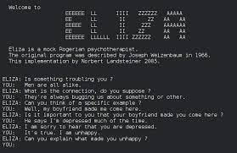
Who was the first chatbot?
ELIZA is considered to be the first chatbot in the history of Computer Science
It was developed by Joseph Weizenbaum at ‘Massachusetts Institute of Technology’ by the year of 1967

Slide 4
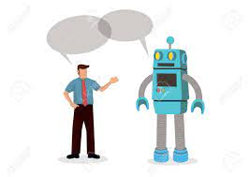
What it was invented for ?
ElIZA was primarily invented to simulate conversations with a psychotherapist. The main purpose of ELIZA was to demonstrate that a computer program could engage in text-based conversations with users and emulate the style of the therapist.

Slide 5
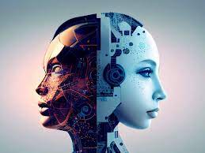
How Does Eliza operates?
Chatbot ELIZA operates by recognizing key words or phrases from the input to reproduce a response using those keywords from pre-programmed responses
Due to its way of working it has very limited understanding

Slide 6
Source
https://en.wikipedia.org/wiki/ELIZA
https://chatbotslife.com/a-brief-history-of-chatbots-d5a8689cf52f
https://web.njit.edu/~ronkowit/eliza.html

Slide 7


